Slide 1
ANHUI HAOJIE PLASTIC & RUBBER PRODUCTS CO., LTD
HAOJIE
latex household gloves

Slide 2
At first
Time!
It’s our

Slide 3
ANHUI HAOJIE PLASTIC & RUBBER PRODUCTS CO., LTD

Slide 4
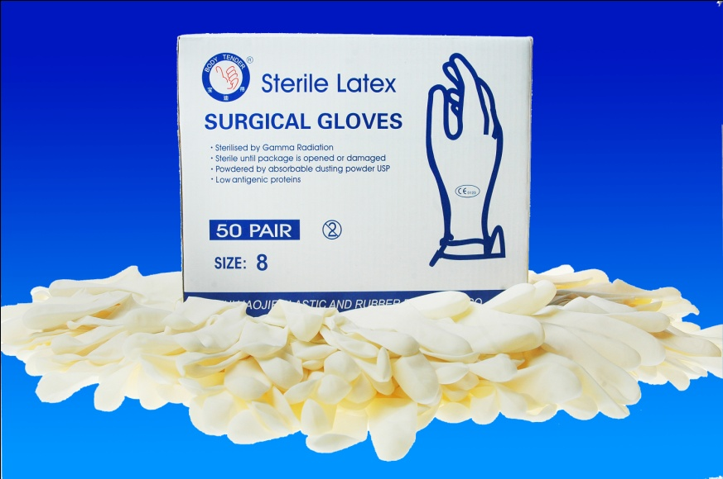
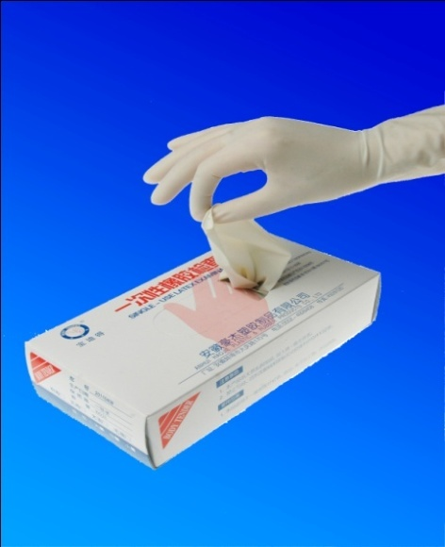
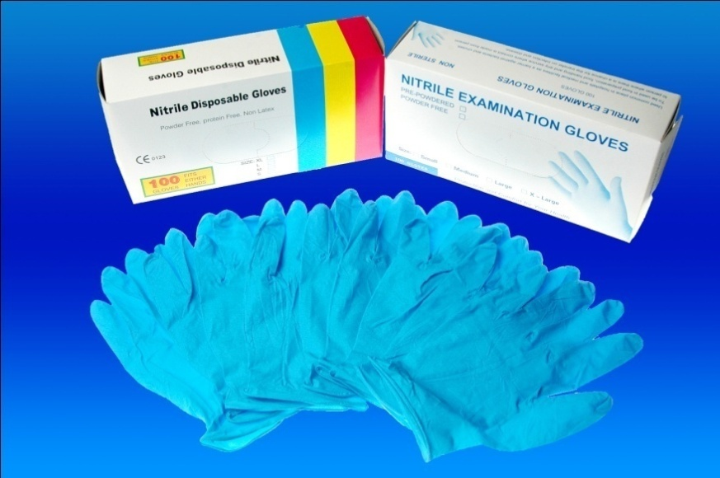
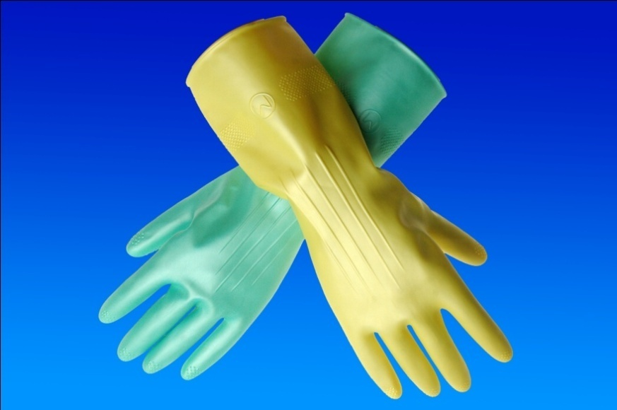
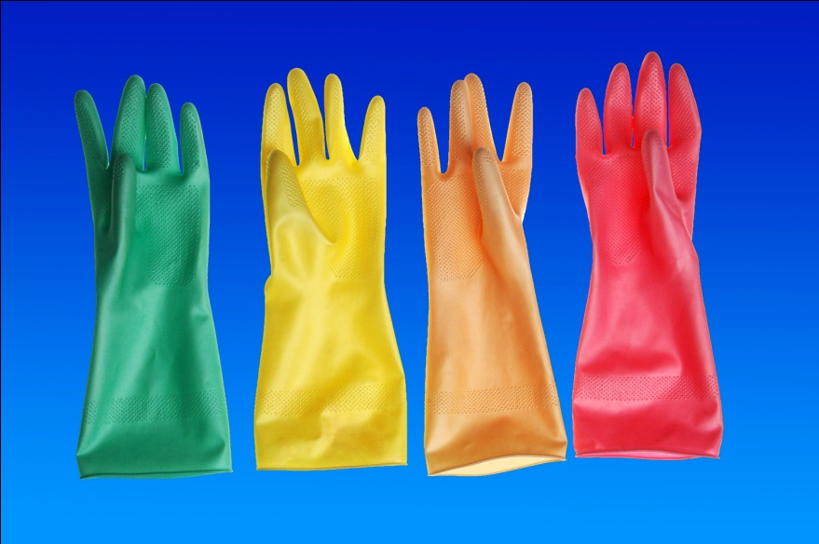
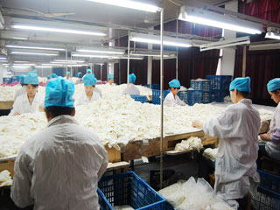
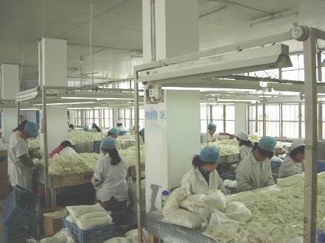
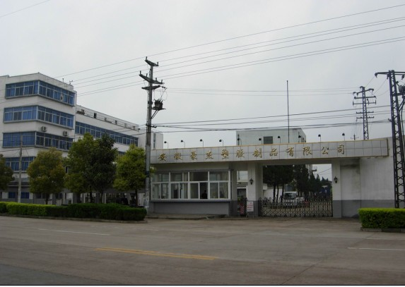
ANHUI HAOJIE PLASTIC & RUBBER PRODUCTS CO., LTD

Slide 5
ANHUI HAOJIE PLASTIC & RUBBER PRODUCTS CO., LTD
HAOJIE
latex household gloves

Slide 6
ANHUI HAOJIE PLASTIC & RUBBER PRODUCTS CO., LTD

Slide 7
ANHUI HAOJIE PLASTIC & RUBBER PRODUCTS CO., LTD
I have a dream~

Slide 8
ANHUI HAOJIE PLASTIC & RUBBER PRODUCTS CO., LTD
Qiao Feng
007

Slide 9
ANHUI HAOJIE PLASTIC & RUBBER PRODUCTS CO., LTD

Slide 10
ANHUI HAOJIE PLASTIC & RUBBER PRODUCTS CO., LTD

Slide 11
ANHUI HAOJIE PLASTIC & RUBBER PRODUCTS CO., LTD

Slide 12
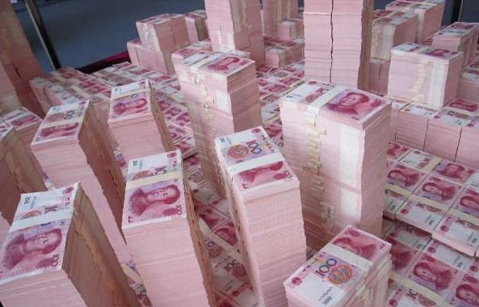
ANHUI HAOJIE PLASTIC & RUBBER PRODUCTS CO., LTD
Your hands, HAOJIE care

Slide 13
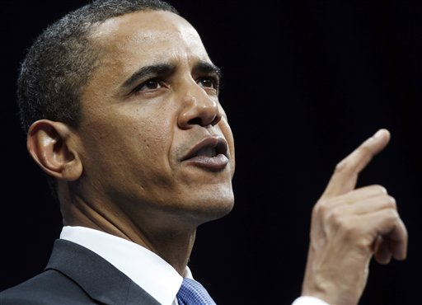
ANHUI HAOJIE PLASTIC & RUBBER PRODUCTS CO., LTD
Your hands, HAOJIE care

Slide 14
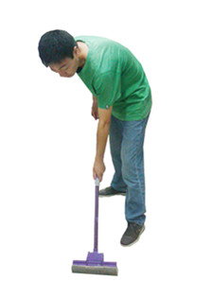
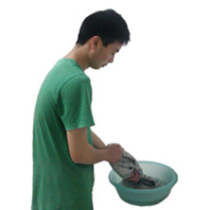
ANHUI HAOJIE PLASTIC & RUBBER PRODUCTS CO., LTD
?
&

Slide 15
ANHUI HAOJIE PLASTIC & RUBBER PRODUCTS CO., LTD
HAOJIE Latex Gloves！

Slide 16
ANHUI HAOJIE PLASTIC & RUBBER PRODUCTS CO., LTD
Characters:
 Soft
 Keep warm
 Affinity
 Elastic
 Durable
 Abrasion resistant
 Smell nice

Slide 17
ANHUI HAOJIE PLASTIC & RUBBER PRODUCTS CO., LTD
Company Introduction
Product
Introduction
Selling points

Slide 18
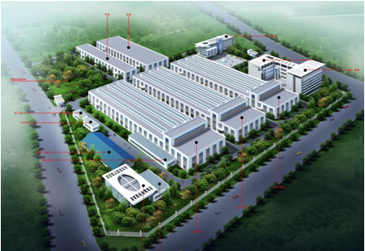
ANHUI HAOJIE PLASTIC & RUBBER PRODUCTS CO., LTD
Company Introduction
★ 50 years
★ government–supported
★ high-tech enterprise
★ complete own technology
★ quality ensure system

Slide 19
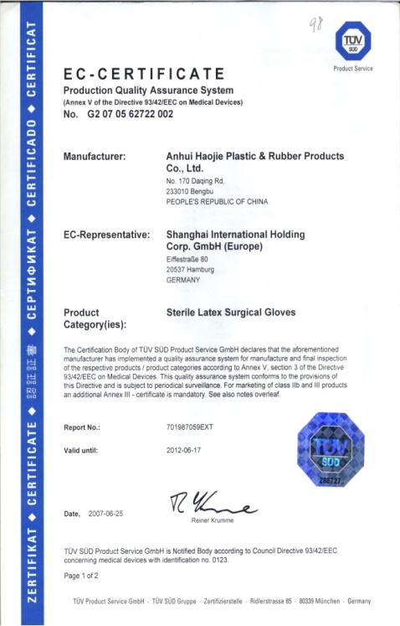
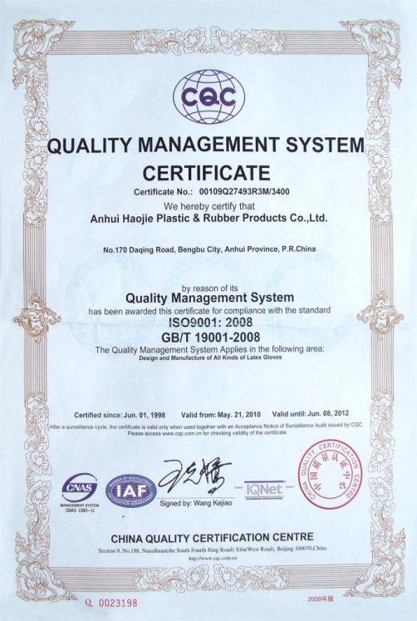
ANHUI HAOJIE PLASTIC & RUBBER PRODUCTS CO., LTD
Company Introduction
CE Certificate
Quality Certificate

Slide 20
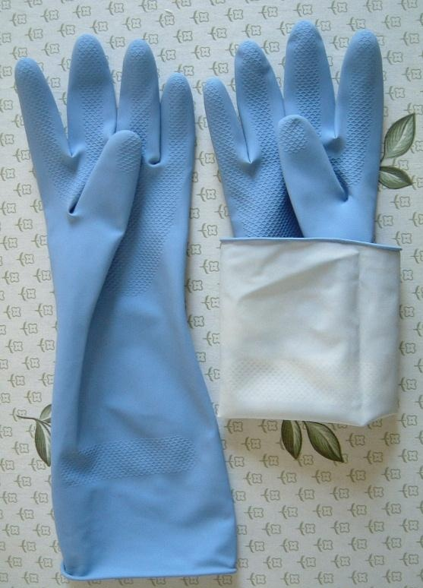
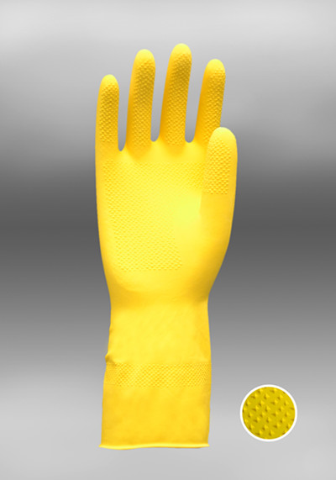
ANHUI HAOJIE PLASTIC & RUBBER PRODUCTS CO., LTD
Product Introduction
★ soft and durable
★ various colors and beautiful
appearances
★ special anti-skidding surface
★ spraying velvet in the
lining of the gloves
Your hands, HAOJIE care

Slide 21
ANHUI HAOJIE PLASTIC & RUBBER PRODUCTS CO., LTD
Selling points
quality
Point 1
Point 2
service
Point 3
Point 4
price
added value

Slide 22
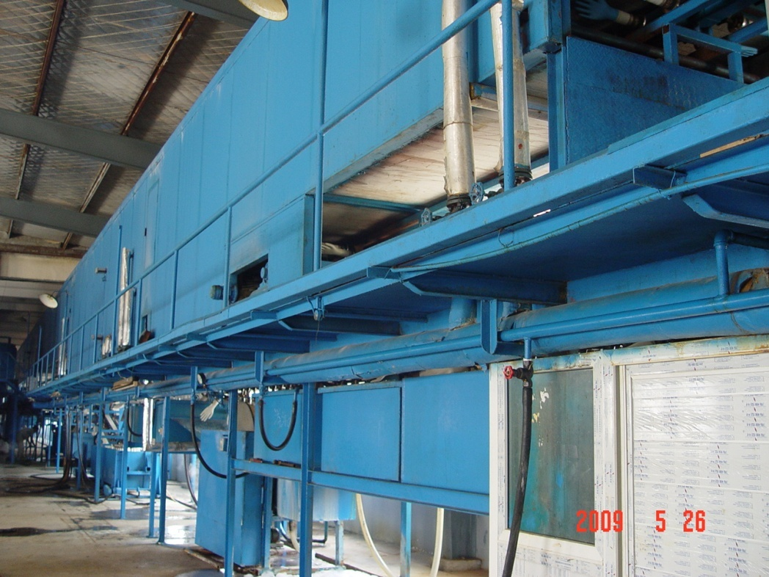
ANHUI HAOJIE PLASTIC & RUBBER PRODUCTS CO., LTD
Quality
★ advanced production lines,
leading techniques
★ solid packing
★ withstand high temperature

Slide 23
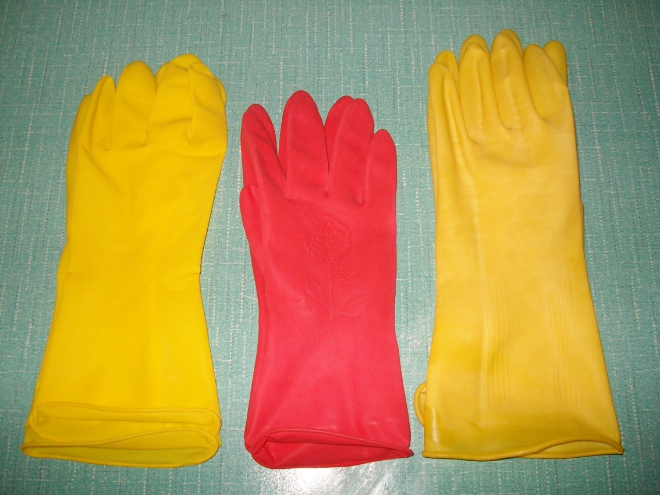
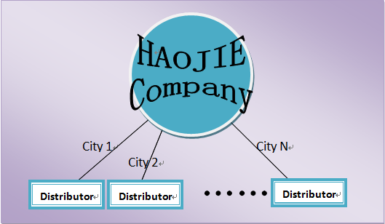
ANHUI HAOJIE PLASTIC & RUBBER PRODUCTS CO., LTD
Service
★ different sizes
★ only one distributor
in each city
★ personalized

Slide 24
ANHUI HAOJIE PLASTIC & RUBBER PRODUCTS CO., LTD
Price
★ cash discount
Amount/boxes | Discount
X≥10000 | 5%
6000≤X＜10000 | 4%
4000≤X＜6000 | 3%
2000≤X＜4000 | 2%
1000≤X＜2000 | 1%
★ trade discount

Slide 25
ANHUI HAOJIE PLASTIC & RUBBER PRODUCTS CO., LTD
Added value
★ environment friendly
★ 1% profit to charity

Slide 26
ANHUI HAOJIE PLASTIC & RUBBER PRODUCTS CO., LTD
Happy Mothers’ Day

